Slide 1
Basic Animations
Click this page to see the images to use
Peter J Faullks

Slide 2
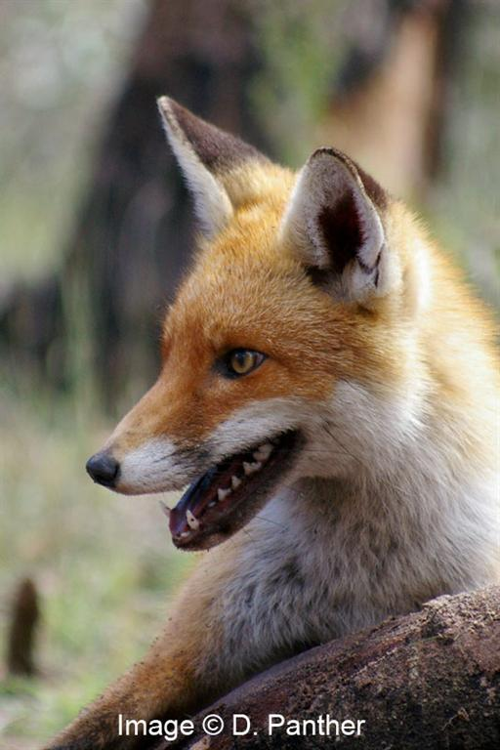
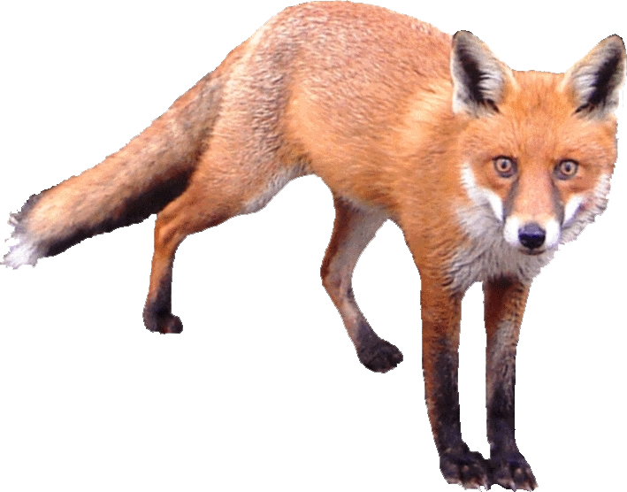
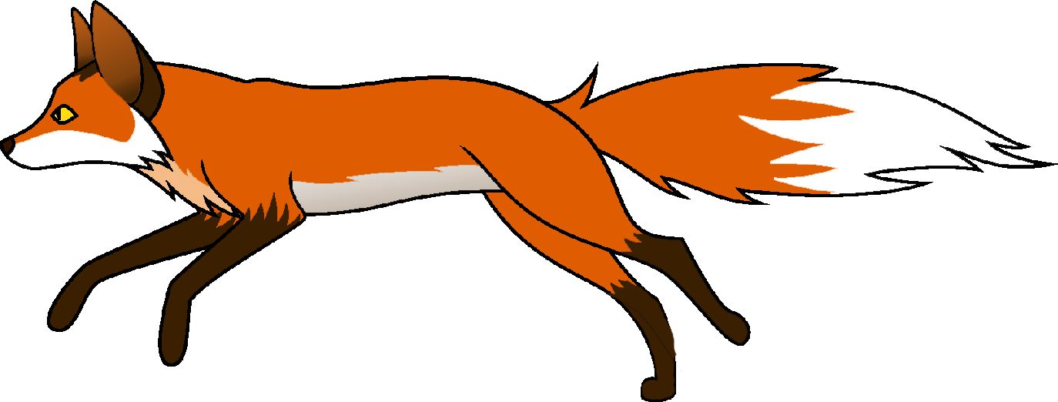
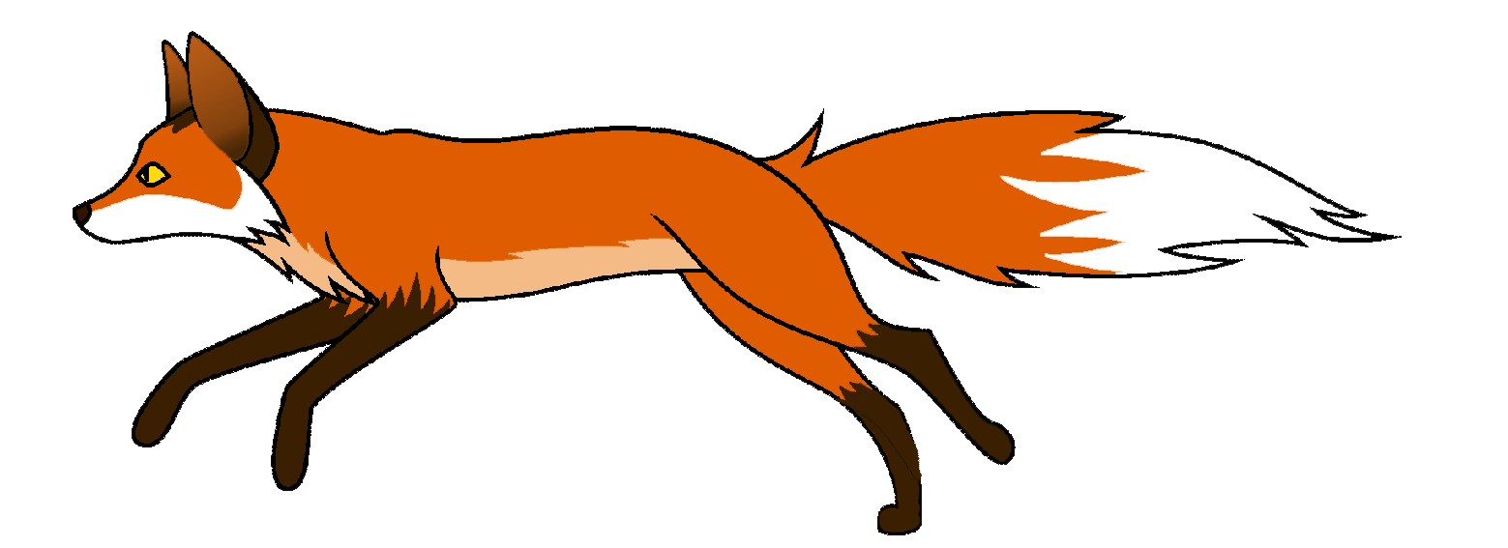
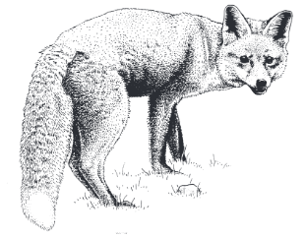
The Fox In Australia
By Peter Faulks
Image 3
Image 2
Image 4
Image 1
Animation 1
Images 6
Click to the next slide
Image 5

Slide 3
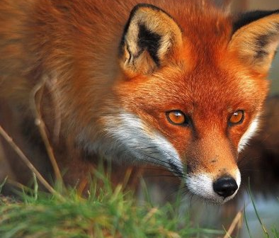
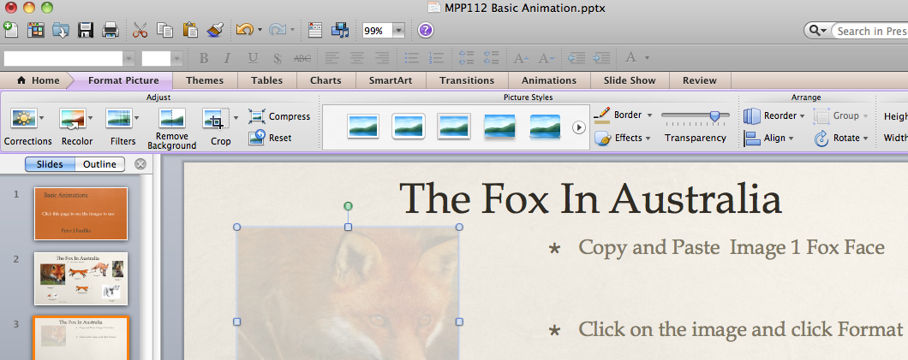
The Fox In Australia
1. Copy and Paste Image 1 Fox Face
2. Click on the image and click Format Picture and change the transparency (Less)
3. Click to the next slide

Slide 4
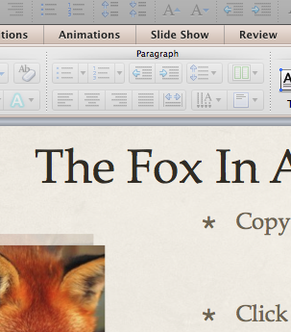
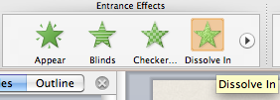
The Fox In Australia
1. Copy and Paste Image 1 Fox Face again
2. Click on the image and click on Animations, then select Dissolve In and you will see a quick dissolve
3. View as slide show slide, you will need to click the mouse to see the animation
click the mouse
4. Click to the next slide

Slide 5
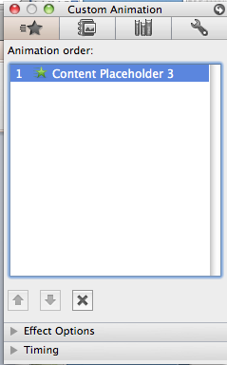
The Fox In Australia
1. Changing the animation
2. The dissolve will only work on a mouse click so we want to change this to automatically change and make the dissolve slower, then we will align the two images
3. Click the image then on the Animations Tab click the Reorder Button on the
4. Select the animation (1) and we will change the effect and timing
5. Click to the next slide

Slide 6
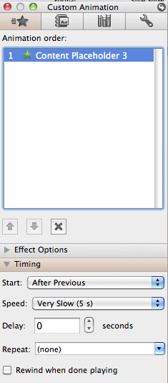
The Fox In Australia
1. Changing the animation
2. Select the image and Reorder then select the image 1
3. Open the Timing Drop Down
4. Change as shown
5. Align the two images
6. Run the show to see the effect
7. Change it to suit your effect
Well Done
8. Click to the next slide

Slide 7
The Fox In Australia
1. Insert the Animation 1 from slide 2
2. Select the image and move it to the left of the screen
3. We will make our fox run across the screen.
4. Click to the next slide

Slide 8
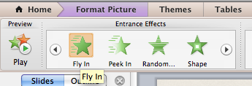
The Fox In Australia
1. Select the Animation 1 (Running Fox)
2. Select Animations and Fly In
3. We will make our fox run from the right
4. Click to the next slide

Slide 9
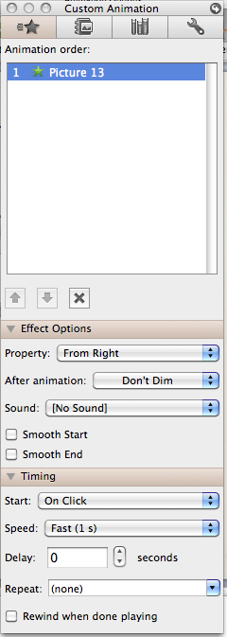
The Fox In Australia
1. Select the Animation 1 (Running Fox)
2. Select Animations and Fly In
3. Then click on Reorder and click on the second animation listed
4. Change the Effect to From Right
5 Then change Timing to Click and Fast
6. Save your work then View show and then Click to the next slide

Slide 10
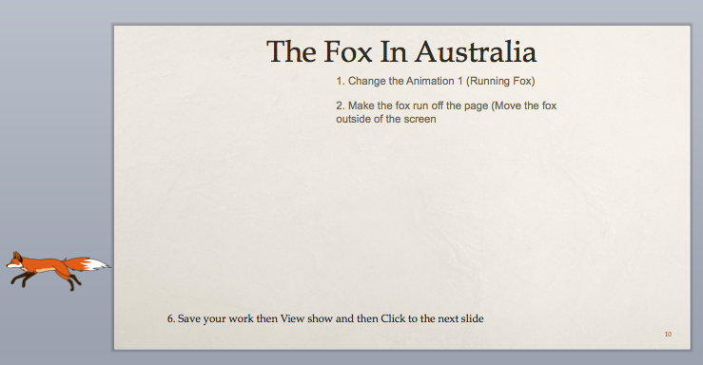
The Fox In Australia
1. Change the Animation 1 (Running Fox)
2. Make the fox run off the page (Move the fox outside of the screen
3. Save your work then View this slide and then Click to the next slide

Slide 11
The Fox In Australia
1. Use some of the other images to create different animations
2. Samples follow
3. Save your work then View this slide and then Click to the next slide

Slide 12
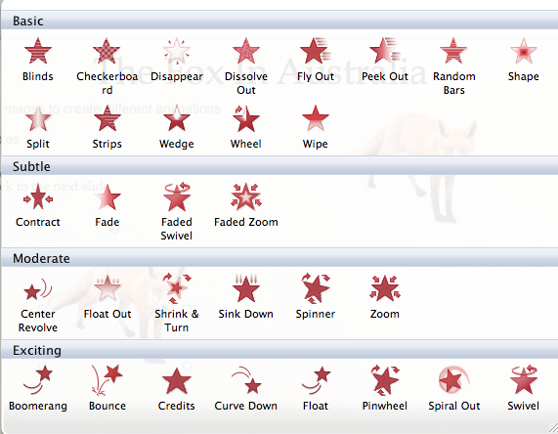
The Fox In Australia
1. More images to create different animations
2. Samples
3. Save your work then View this slide and then Click to the next slide

Slide 13
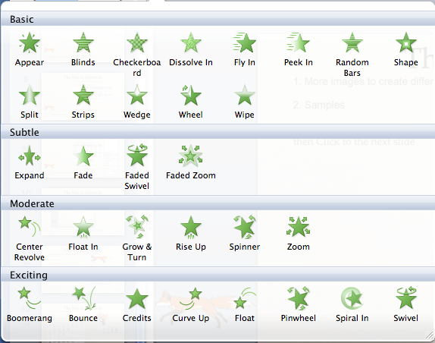
The Fox In Australia
1. More images to create different animations
2. Samples
3. Save your work then View this slide and then Click to the next slide

